Slide 1
Analysis of A/B Test Results
Data Scientist:
Mohamed Soliman
© 2024 Udacity.

Slide 2
Agenda
Findings of A/B test analysis
Experiment Setup
Conversion Rates
Experiment Results

Slide 3
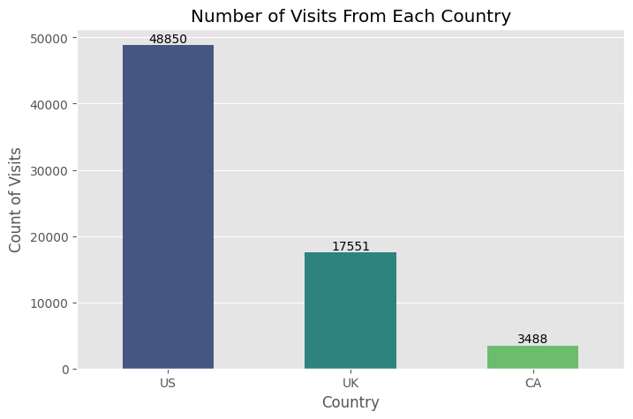
How Was the Experiment Implemented?
Total Variant Visitors: 35,211
Total Control Participants:
34,678

Slide 4
Conversion Rates
 | U.S. | U.K. | CA
Control | 10.7% | 10.1% | 09.4%
Treatment | 15.8% | 14.8% | 15.4%
There is no obivious interaction between how country and treatment impact conversion.

Slide 5
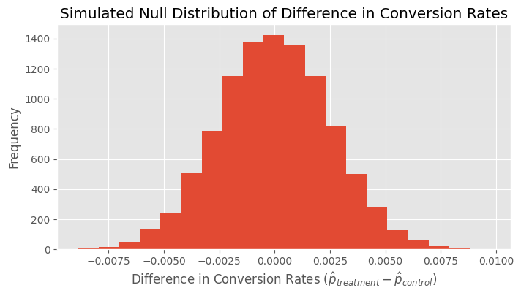
Experiment Results
Treatment Conversion Rate: 0.15532
Control Conversion Rate:​ 0.10525
Delta in Treatment vs. Control Conversion Rate: ~ 0.05007

Slide 6
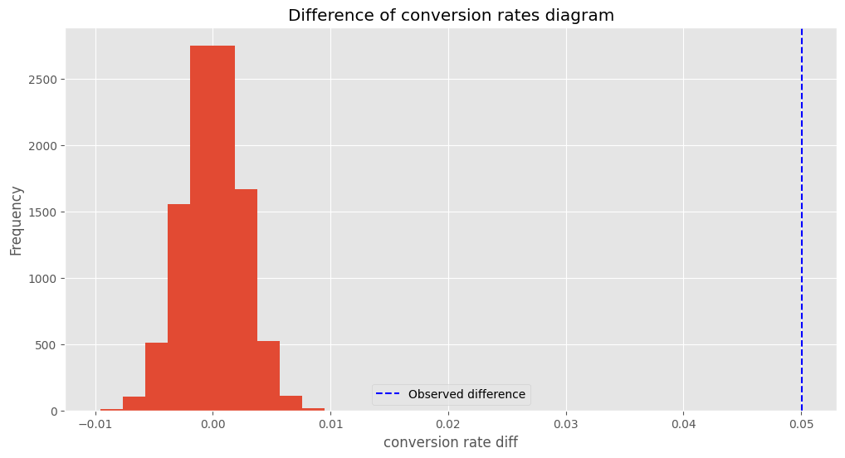
Experiment Results

Slide 7
Experiment Results
p-value:​ 0.0000
Conclusion:
p-value < 0.05
0% is the proportion of the p_diffs that are greater than the actual difference observed in ab_data.csv. This p-value means that we can reject the null hypothesis and that we have sufficient evidence that the new_page has a higher conversion rate than the old_page.

